Slide 1
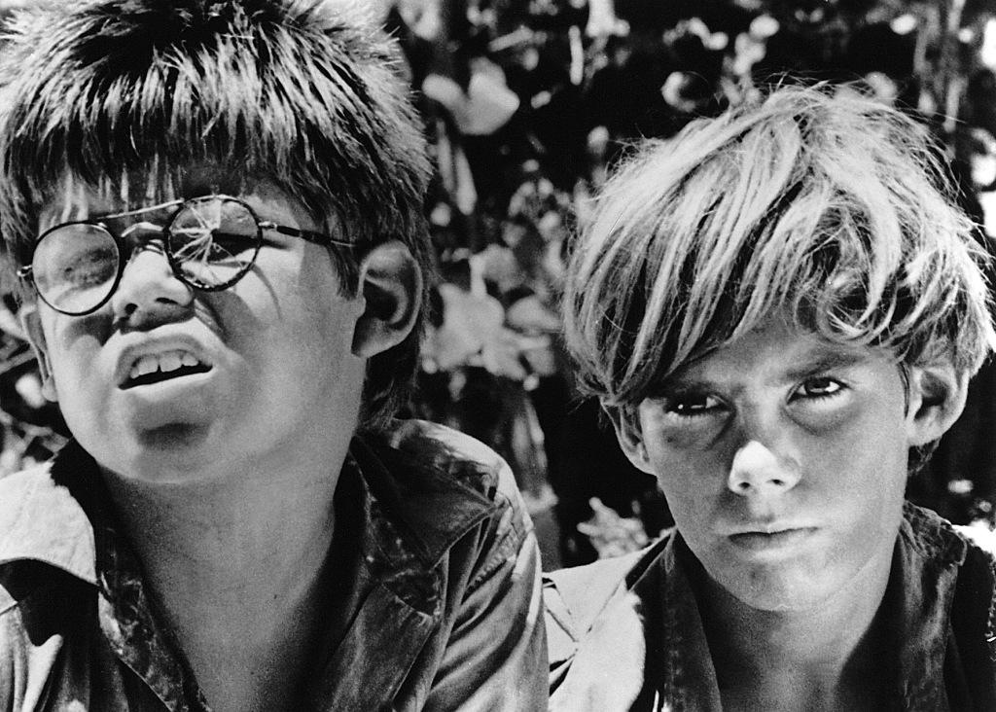
Lord of the flies
a presentation by Svenja Golnik, Q4

Slide 2
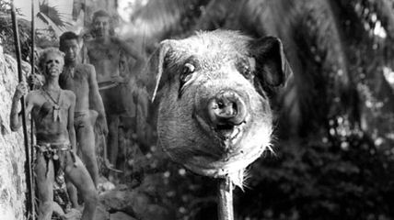
Content
Information about the book
Plot
Scene of the movie
A little excursion to Dystopia
Why is the story dystopian?
Could the story become reality?
Sources
Scene of the film

Slide 3
Information about „Lord of the flies“
author: William Golding
publication date: 17th September 1954
novel
original language: English
number of pages: 224
day of the filming: 16th March 1990
screenwriter: Jay Presson Allen
original UK book cover

Slide 4
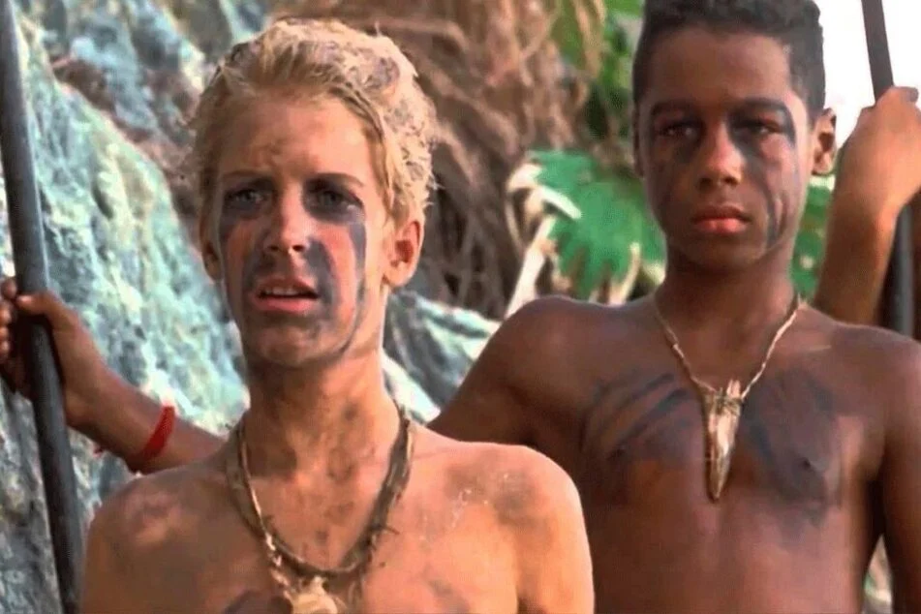
Plot
group of boys
outcast in the wild after plane accident
fight for survival
afraid of the beast
protagonist: Ralph (leader of the one group)
antagonist: Jack (wannabe-leader)
Ralph -> good one
Jack -> bad guy (bullies the weak)
scenes of the film

Slide 5
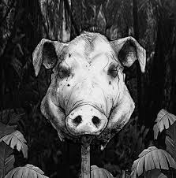
groups seperate
hatred between both groups
opposites and power struggles
pig head “talks“ to Simon (group member)
“Fancy thinking the Beast was something you could hunt and kill!... You knew, didn‘t you?“
sacrifice
“small“ war
become rescued by a captain of a ship
again a picture of the pig head „lord of the flies“

Slide 6
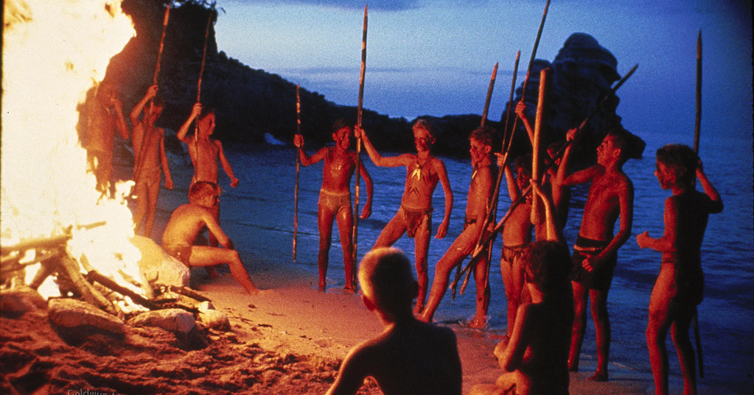
Scene of the movie
to show the dimensions
https://www.youtube.com/watch?v=2aiVI2zBW3g
picture of the scene

Slide 7
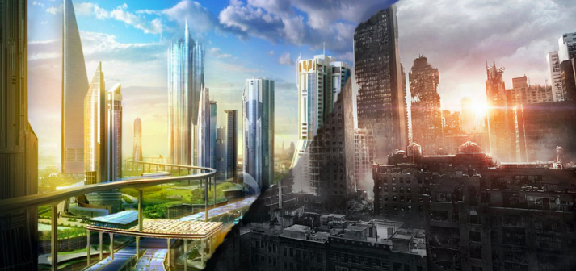
A little excursion to Dystopia
opposite of Utopia (Anti-Utopia)
bad place to live in
society developed to the negative
often totalitarian system
picture of Utopia and Dystopia

Slide 8
Why is the story dystopian?
chance for a new, better world/society
2 groups against each other (after seperation)
instead of living in peace together -> war (different views)
totalitarian system? (both groups -> leaders)
really messed up society results (for example: sacrifice)

Slide 9
Could the story become reality?
Pro
Contra
plane accidents can happen
need for a leader
hope for a new beginning (new society)
different views in societies
violence as a solution
survival after plane accident improbable
knowledge about consequences (enlightenment)
humanity is civilized
urge for peace in almost every person
children aren‘t that brutal

Slide 10
Sources
https://en.wikipedia.org/wiki/Lord_of_the_Flies
https://www.cinema.de/film/herr-der-fliegen,1296387.html
https://www.mz-web.de/kultur/geschichte-von-gestrandeten-jugendlichen--der-wahre-herr-der-fliegen--wird-verfilmt-36741994
https://www.tag24.de/nachrichten/herr-der-fliegen-literatur-klassiker-kultroman-dritte-verfilmung-suspiria-regisseur-luca-guadagnino-1152681
https://www.wrpawprint.com/arts-entertainment/2014/05/27/lord-of-the-flies-a-timeless-classic/
https://www.slashfilm.com/lord-of-the-flies-movie-luca-guadagnino/
https://www.enotes.com/homework-help/what-lord-flies-tell-simon-lord-flies-225533
http://raysfilme3.blogspot.com/2017/05/herr-der-fliegen.html

Slide 11
Thank you for your attention!

